Slide 1
iOS – Views and Drawing
CS4521

Slide 2
Views
Rectangular area on screen
  • Draws content
  • Handles events
  • Subclass of UIResponder (event handling class)
  • Views arranged hierarchically
Views arranged hierarchically
  every view has one superview
  every view has zero or more subviews

Slide 3
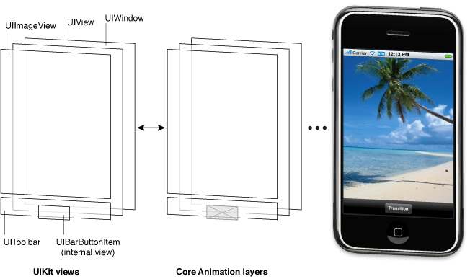
UIWindow
Views live inside of a window
UIWindow is actually just a view
  adds some additional functionality specific to top level view
One UIWindow for an iPhone app
  Contains the entire view hierarchy
  Set up by default in Xcode template project

Slide 4
Creating and Adding Views
Use Interface Builder and do it with GUI
OR
Do it in Programming code
Add/remove views in IB or using UIView methods
- (void)addSubview:(UIView *)view;
- (void)removeFromSuperview;
Manipulate the view hierarchy manually:
- (void)insertSubview:(UIView *)view atIndex:(int)index;
- (void)insertSubview:(UIView *)view belowSubview:(UIView *)view;
- (void)insertSubview:(UIView *)view aboveSubview:(UIView *)view;
- (void)exchangeSubviewAtIndex:(int)index
withSubviewAtIndex:(int)otherIndex;

Slide 5
Hiding a View
ViewObject.hidden = YES;

Slide 6
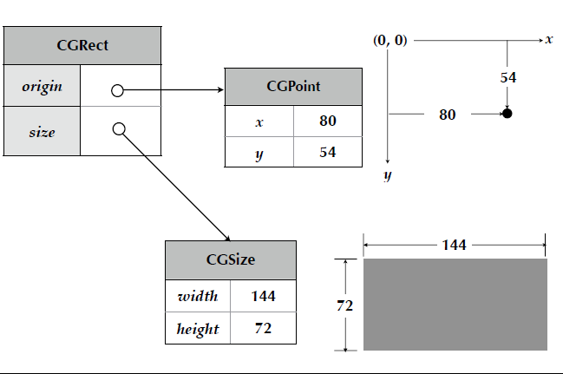
Supporting the View
There are many “utility” classes / structures that support creation and manipulation of a View. Here are a few
CGPoint
  location in space: { x , y }
CGSize
  dimensions: { width , height }
CGRect
  location and dimension: { origin , size }

Slide 7
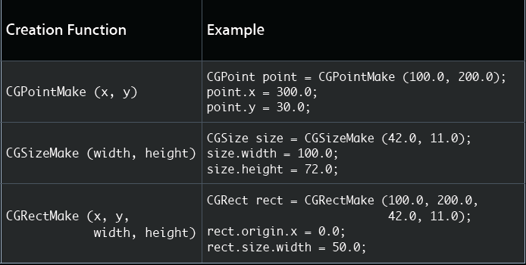
More on Supporting Classes

Slide 8
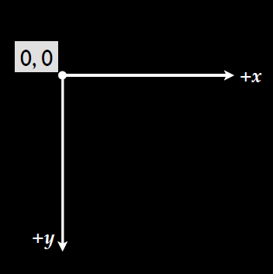
Screen Coordinate System
Origin = upper left corner

Slide 9
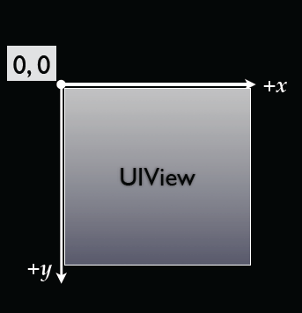
UIView cooridinate system
View’s location and size expressed in two ways
■ Frame is in superview’s coordinate system
■ Bounds is in local coordinate system

Slide 10
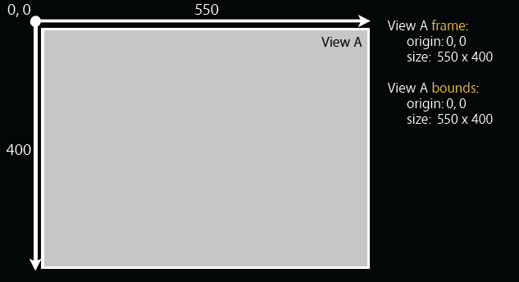
Example of setting location for 2 views
First View A

Slide 11
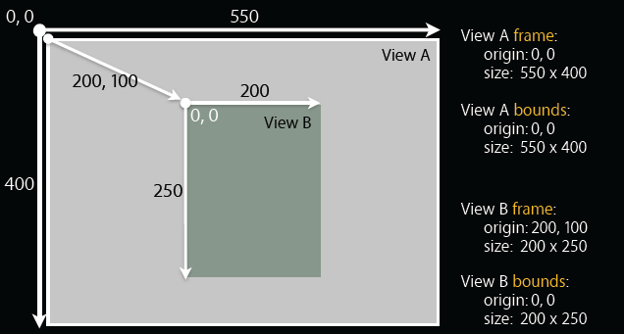
Example of setting location for 2 views
View B

Slide 12
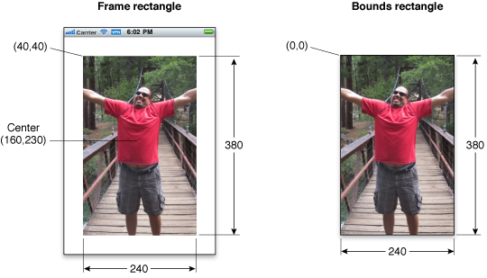
Frame and Views—a visual exampl

Slide 13
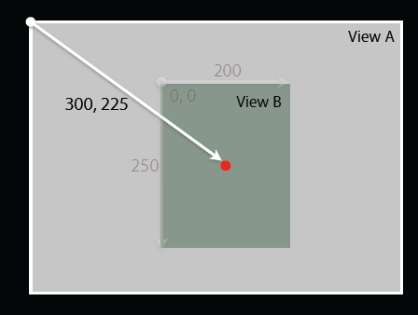
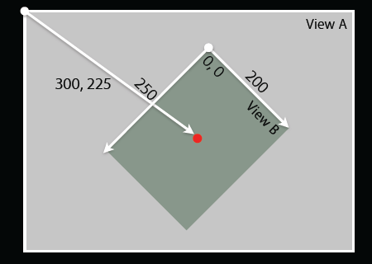
Rotations around Center
Rotation is done around center of View
Shown here – transformation is 45degree rotation

Slide 14

What is the Frame?
The smallest rectangle in the superview’s coordinate system that fully encompasses the view itself

Slide 15
Frames and Bounds –which one??
Which to use?
■ Usually depends on the context
  If you are using a view, typically you use frame
  If you are implementing a view, typically you use bounds
■ From outside it’s usually the frame
■ From inside it’s usually the bounds
Examples:
Creating a view, positioning a view in superview - use frame
Handling events, drawing a view - use bounds

Slide 16
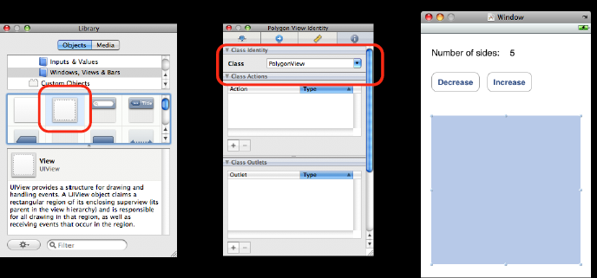
Creating View with help of Interface Builder
Commonly Interface Builder
Drag out any of the existing view objects (buttons, labels, etc)
Or drag generic UIView and set custom class

Slide 17
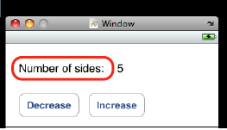
Creating View in Code
Views are initialized using -initWithFrame:
  CGRect frame = CGRectMake(0, 0, 200, 150);
  UIView *myView = [[UIView alloc] initWithFrame:frame];
• Example:
  CGRect frame = CGRectMake(20, 45, 140, 21);
  UILabel *label = [[UILabel alloc] initWithFrame:frame];
  [window addSubview:label];
  [label setText:@”Number of sides:”];
  [label release]; // label now retained by window

Slide 18
Defining your own View Class
You Must Subclass UIView
• For custom drawing, you override:
  (void)drawRect:(CGRect)rect;
• For event handling, you override:
  - (void)touchesBegan:(NSSet *)touches withEvent:(UIEvent *)event;
  - (void)touchesMoved:(NSSet *)touches withEvent:(UIEvent *)event;
  - (void)touchesEnded:(NSSet *)touches withEvent:(UIEvent *)event;
  - (void)touchesCancelled:(NSSet *)touches withEvent:(UIEvent *)event;

Slide 19
Drawing …..

Slide 20
Drawing Views
- (void)drawRect:(CGRect)rect
  -[UIView drawRect:] does nothing by default
    ■ If not overridden, then backgroundColor is used to fill
• Override - drawRect: to draw a custom view
  rect argument is area to draw
• When is it OK to call drawRect:?
  Be Lazy
    • drawRect: is invoked automatically
  ■ Don’t call it directly!
When a view needs to be redrawn, use:
  - (void)setNeedsDisplay;
• For example, in your controller:
  - (void)setNumberOfSides:(int)sides {
  numberOfSides = sides;
  [polygonView setNeedsDisplay];
  }

Slide 21
How do we draw inside our overridden drawRect??? Use Core Graphics and Quartz 2D
UIKit offers very basic drawing functionality
  UIRectFill(CGRect rect);
  UIRectFrame(CGRect rect);
• CoreGraphics: Drawing APIs
• CG is a C-based API, not Objective-C
• CG and Quartz 2D drawing engine define simple but powerful graphics primitives
  ■ Graphics context
  ■ Transformations
  ■ Paths
  ■ Colors
  ■ Fonts
  ■ Painting operations

Slide 22
Core Graphics Wrappers
Some CG functionality wrapped by UIKit – examples
• UIColor
      ■ Convenience for common colors
      ■ Easily set the fill and/or stroke colors when drawing
      UIColor *redColor = [UIColor redColor];
      [redColor set]; // drawing will be done in red
• UIFont
      ■ Access system font
      ■ Get font by name
      UIFont *font = [UIFont systemFontOfSize:14.0];
      [myLabel setFont:font];

Slide 23
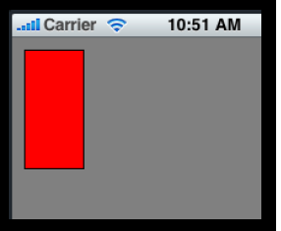
drawRect example
Draw a solid color and shape
  - (void)drawRect:(CGRect)rect {
  CGRect bounds = [self bounds];
  [[UIColor grayColor] set];
  UIRectFill (bounds);
  CGRect square = CGRectMake (10, 10, 50, 100);
  [[UIColor redColor] set];
  UIRectFill (square);
  [[UIColor blackColor] set];
  UIRectFrame (square);
  }

Slide 24
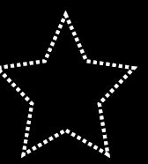
Drawing paths
CoreGraphics paths define shapes
• Made up of lines, arcs, curves and rectangles
• Creation and drawing of paths are two distinct operations
  Define path first, then draw it

Slide 25
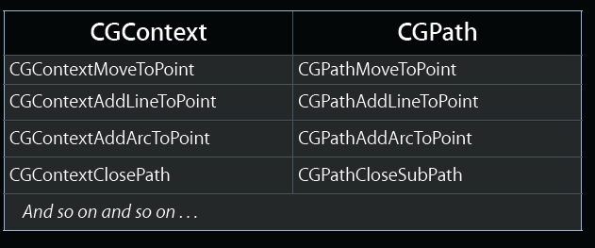
CGPath
Two parallel sets of functions for using paths
■ CGContext “convenience” throwaway functions
■ CGPath functions for creating reusable paths

Slide 26
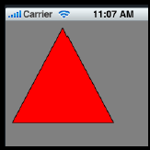
drawRect example w/path
- (void)drawRect:(CGRect)rect {
  CGContextRef context = UIGraphicsGetCurrentContext();
  [[UIColor grayColor] set];
  UIRectFill ([self bounds]);
  CGContextBeginPath (context);
  CGContextMoveToPoint (context, 75, 10);
  CGContextAddLineToPoint (context, 10, 150);
  CGContextAddLineToPoint (context, 160, 150);
  CGContextClosePath (context);
  [[UIColor redColor] setFill];
  [[UIColor blackColor] setStroke];
  CGContextDrawPath (context, kCGPathFillStroke);
}
Common steps for drawRect: are
■ Get current graphics context
■ Define a path
■ Set a color
■ Stroke or fill path
■ Repeat, if necessary

Slide 27
UIImage - Images
UIKit class to represent an Image
Creating UIImages:
  ■ Fetching image in application bundle
    Use +[UIImage imageNamed:(NSString *)name]
    Include file extension in file name, e.g. @”myImage.jpg”
  ■ Read from file on disk
    Use -[UIImage initWithContentsOfFile:(NSString *)path]
  ■ From data in memory
    Use -[UIImage initWithData:(NSData *)data]

Slide 28
Example – creating Image from context
• Need to dynamically generate a bitmap image
• Same as drawing a view
• General steps
  Create a special CGGraphicsContext with a size
  Draw
  Capture the context as a bitmap
  Clean up
- (UIImage *)polygonImageOfSize:(CGSize)size {
  UIImage *result = nil;
  UIGraphicsBeginImageContext (size);
  // call your drawing code...
  result = UIGraphicsGetImageFromCurrentContext();
  UIGraphicsEndImageContext();
  return result;
}

Slide 29
Grabbing the Data/pixels in a UIImage
Given UIImage, want PNG or JPG representation
  NSData *UIImagePNGRepresentation (UIImage * image);
  NSData *UIImageJPGRepresentation (UIImage * image);
• UIImage also has a CGImage property which will give you a CGImageRef to use with CG calls
You may want the data in the Image so you can manipulate it → do image processing

Slide 30
Drawing Images and Text
Two ways
In code –programatically
Using built-in classes of UIImageView and UILabel

Slide 31
Option 1: Drawing Image in Program coding
You can draw UIImages in -drawRect:
  - [UIImage drawAtPoint:(CGPoint)point]
  - [UIImage drawInRect:(CGRect)rect]
  - [UIImage drawAsPatternInRect:(CGRect)rect]

Slide 32
Drawing Text
You can draw NSString in -drawRect:
  - [NSString drawAtPoint:(CGPoint)point withFont:(UIFont *)font]

Slide 33
Option 2: using UIImageView andUILabel
We have already seen a number of UILabel examples…esay to use –just create and add to your UIView…nothing more
UILabel Properties include:
■ font
■ textColor
■ shadow (offset & color)
■ textAlignment

Slide 34
Option 2: UIImageView
Draws an instance of UIImage
UIImageView Properties include:
■ image
■ animatedImages
■ animatedDuration
■ animatedRepeatCount
■ contentMode property to align and scale image wrt bounds

Slide 35
UIControl: UILabel versus UITextField
UIControl is UIView with Target-Action event handling
Properties include:
  enabled
  selected
  highlighted
Subclasses:
  UITextField: font, text, placeholder, textColor
  UIButton: font, title, titleColor, image, backgroundImage
UIView
UILabel
UIControl
UITextField
If your View is to have events will descend from UIControl

Slide 36
What’s next → the View lifecycle

Slide 37
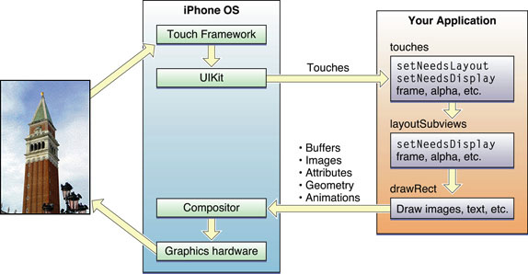
View Lifecycle

Slide 38
View Lifecycle
The user touches the screen.
The hardware reports the touch event to the UIKit framework.
The UIKit framework packages the touch into a UIEvent object and dispatches it to the appropriate view.

Slide 39
View Lifecycle
The event-handling code of your view responds to the event. For example, your code might:
  Change the properties (frame, bounds, alpha, and so on) of the view or its subviews.
  Call the setNeedsLayout method to mark the view (or its subviews) as needing a layout update.
  Call the setNeedsDisplay or setNeedsDisplayInRect: method to mark the view (or its subviews) as needing to be redrawn.
  Notify a controller about changes to some piece of data for iOS.)

Slide 40
View Lifecycle
If the geometry of a view changed for any reason, UIKit updates its subviews
If any part of any view was marked as needing to be redrawn, UIKit asks the view to redraw itself.
For custom views that explicitly define a drawRect: method,
  UIKit calls that method.

Slide 41
View Lifecycle
Standard system views typically do not implement a drawRect: method but instead manage their drawing at this time.
Any updated views are composited with the rest of the application’s visible content and sent to the graphics hardware for display.
The graphics hardware transfers the rendered content to the screen.

Slide 42
View Lifecycle
If the geometry of a view changed for any reason, UIKit updates its subviews

Slide 43
View Lifecycle
The following steps break the event sequence in Figure 1-7 down even further and explain what happens at each stage and how you might want your application to react in response.
The user touches the screen.
The hardware reports the touch event to the UIKit framework.
The UIKit framework packages the touch into a UIEvent object and dispatches it to the appropriate view. (For a detailed explanation of how UIKit delivers events to your views, see Event Handling Guide for iOS.)
The event-handling code of your view responds to the event. For example, your code might:
  Change the properties (frame, bounds, alpha, and so on) of the view or its subviews.
  Call the setNeedsLayout method to mark the view (or its subviews) as needing a layout update.
  Call the setNeedsDisplay or setNeedsDisplayInRect: method to mark the view (or its subviews) as needing to be redrawn.
  Notify a controller about changes to some piece of data.
Of course, it is up to you to decide which of these things the view should do and which methods it should call.
If the geometry of a view changed for any reason, UIKit updates its subviews according to the following rules:
  If you have configured autoresizing rules for your views, UIKit adjusts each view according to those rules. For more information about how autoresizing rules work, see “Handling Layout Changes Automatically Using Autoresizing Rules.”
  If the view implements the layoutSubviews method, UIKit calls it.
  You can override this method in your custom views and use it to adjust the position and size of any subviews. For example, a view that provides a large scrollable area would need to use several subviews as “tiles” rather than create one large view, which is not likely to fit in memory anyway. In its implementation of this method, the view would hide any subviews that are now offscreen or reposition them and use them to draw newly exposed content. As part of this process, the view’s layout code can also invalidate any views that need to be redrawn.
If any part of any view was marked as needing to be redrawn, UIKit asks the view to redraw itself.
For custom views that explicitly define a drawRect: method, UIKit calls that method. Your implementation of this method should redraw the specified area of the view as quickly as possible and nothing else. Do not make additional layout changes at this point and do not make other changes to your application’s data model. The purpose of this method is to update the visual content of your view.
Standard system views typically do not implement a drawRect: method but instead manage their drawing at this time.
Any updated views are composited with the rest of the application’s visible content and sent to the graphics hardware for display.
The graphics hardware transfers the rendered content to the screen.

